Slide 1
Introduction to Programming with Python
Vineet Bansal
Research Software Engineer, Center for Statistics & Machine Learning
vineetb@princeton.edu
June 12-28, 2018

Slide 2
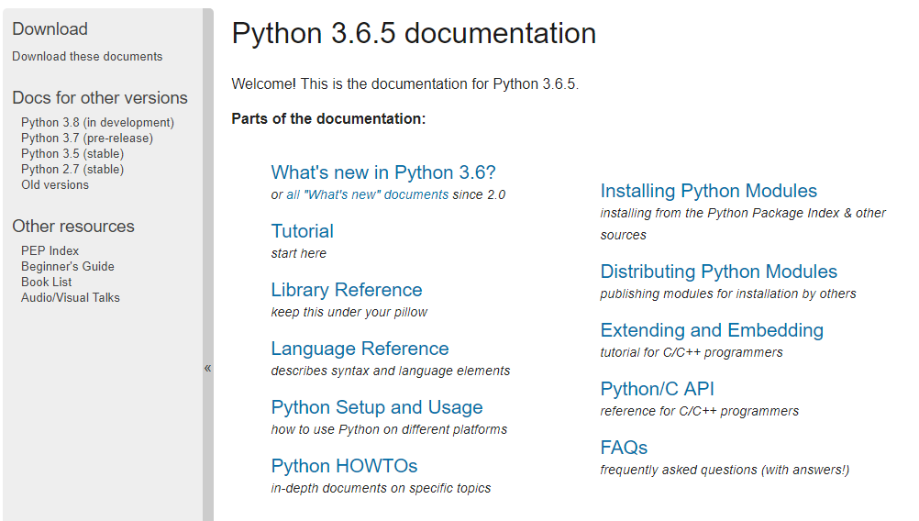
http://docs.python.org

Slide 3
The Python Interpreter
Typical Python implementations offer both an interpreter and compiler
Interactive interface to Python with a read-eval-print loop
C:\Users\Vineet Bansal>python
Python 3.6.3 |Anaconda custom (64-bit)| (default, Oct 15 2017, 03:27:45) [MSC v.1900 64 bit (AMD64)] on win32
Type "help", "copyright", "credits" or "license" for more information.
>>> print('hello world')
hello world
>>> x = 1
>>> x
1
>>> exit()

Slide 4
Variables
First assignment to a variable creates it
Variable types don’t need to be declared.
Python figures out the variable types on its own.
Assignment is = and comparison is ==
For numbers + - * / % are as expected
Special use of + for string concatenation
Logical operators are words (and, or, not) not symbols
The basic printing command is print

Slide 5
Basic Datatypes
Integers (default for numbers)
z = 5 / 2 # Answer 2, or 2.5 ?
Floats
x = 3.456
Strings
Can use “” or ‘’ to specify with “abc” == ‘abc’
Unmatched can occur within the string: “matt’s”
Use triple double-quotes for multi-line strings or strings than contain both ‘ and “ inside of them: “““a‘b“c”””

Slide 6
Assignment
Binding a variable in Python means setting a name to hold a reference to some object
Assignment creates references, not copies
Names in Python do not have an intrinsic type, objects have types
Python determines the type of the reference automatically based on what data is assigned to it
You create a name the first time it appears on the left side of an assignment expression: x = 3
A reference is deleted via garbage collection after any names bound to it have passed out of scope
Assignments can be chained
a = b = x = 3 # Are these referring to the same location?

Slide 7
Accessing Non-existent Name
Accessing a name before it’s been properly created (by placing it on the left side of an assignment), raises an error
>>> y
Traceback (most recent call last):
File "<pyshell#16>", line 1, in -toplevel-
y
NameError: name ‘y' is not defined
>>> y = 3
>>> y
3

Slide 8
Overwriting Variables
The right side of an expression is evaluated and the name on the left side points to it, so its possible to do:
>>> y = 10
>>> y = y + 1
>>> y
11
>>> y += 1
>>> y
12
Augmented assignment operators can be used as a shortcut:
+= -= *= /= //= %=
&= |= ^= >>= <<= **=

Slide 9
The id function
Each variable points to a location in memory, accessible by the ‘id’ function
>>> x = 1000
>>> id(x)
2072729076848
>>> y = 1000
>>> id(y)
2072729078000
>>> x==y
True
>>> x is y
False
Consider this. Why did y not change?
>>> x = y = 1000
>>> x is y
>>> True
>>> x = 2000
>>> x
>>> 2000
>>> y
>>> 1000

Slide 10
Naming Rules
Names are case sensitive and cannot start with a number. They can contain letters, numbers, and underscores.
bob Bob _bob _2_bob_ bob_2 BoB
There are some reserved words:
False class finally is return
None continue for lambda try
True def from nonlocal while
and del global not with
as elif if or yield
assert else import pass
break except in raise

Slide 11
Naming Conventions
The Python community has these recommended naming conventions
snake_case for functions, methods and, attributes
snake_case or ALL_CAPS for constants
StudlyCaps for classes
camelCase only to conform to pre-existing conventions
Attributes: interface, _internal, __private

Slide 12
Arithmetic Operators
a = 10 # 10
a += 1 # 11
a -= 1 # 10
b = a + 1 # 11
c = a -1 # 9
d = a * 2 # 20
e = a / 2 # 5
f = a % 3 # 1
g = a ** 2 # 100

Slide 13
Arithmetic Operator precedence
** (highest precedence)
*,/,//,%
+,- (lowest precedence)
Operators of equal precedence are evaluated left to right, with the exception of exponentiation (**), evaluated right to left
Consider these:
>>> 6 / 2 / 4
>>> 6 / (2 / 4)
>>> 2**2**3
Write an expression to convert a given temperature in Fahrenheit to Celsius, and vice versa.

Slide 14
Parenthesizing
Parenthesize Expressions to make life easier for you and everyone reading your code!
“Explicit is better than implicit.” – The Zen of Python, by Tim Peters

Slide 15
Built-in Functions
>>> print(‘Hello World’)
Hello World
‘print’ is not in the list of reserved words. What gives?
Python has some “built-in” functions:
abs() dict() help() min() setattr()
all() dir() hex() next() slice()
any() divmod() id() object() sorted()
ascii() enumerate() input() oct() staticmethod()
bin() eval() int() open() str()
bool() exec() isinstance() ord() sum()
bytearray() filter() issubclass() pow() super()
bytes() float() iter() print() tuple()
callable() format() len() property() type()
chr() frozenset() list() range() vars()
classmethod() getattr() locals() repr() zip()
compile() globals() map() reversed() __import__()
complex() hasattr() max() round()
delattr() hash() memoryview() set()
As opposed to keywords, we can overwrite these (But really shouldn’t!)

Slide 16
Using functions from other modules
The built-in functions only get us so far.
Calculate the area of a triangle given the length of its 3 sides.
Exercise 1.1

Slide 17
Importing Modules
Modules can be renamed on import. You may see this kind of code a lot:
import numpy as np
import tensorflow as tf
Why bother?
“Practicality beats purity.” – The Zen of Python
import this

Slide 18
Importing Modules
Modules give us functions as well as useful constants.
Find the area of a circle given its radius.
Exercise 1.2
We can import the entire module, or only what we know we’re going to use.
import math
from math import sqrt
We can import everything inside the module
From math import *
But really shouldn’t!
Exercise 1.3

Slide 19
Comparison Operators
==, !=, <>, >, <, >=, <=
>>> x = 10
>>> x>5
True
What did we get back from this expression? A boolean!

Slide 20
Booleans
>>> x = True
>>> y = False
Logic Operators not, and, or can be used with booleans.
>>> not x
False
>>> x and y
False
>>> x or y
True

Slide 21
Booleans
Any expression can be cast as a boolean.
>>> x = 42
>>> bool(x)
True
>> bool(0)
False
>>> bool(‘’)
False
Python will try to convert an object to ‘bool’ if it needs to.
>>> x or False
42
Short-Circuited Expressions – What’s happening here?
>> y = 0 or 42 or 1/0

Slide 22
Python’s special value, None
Used to represent absence of a value.
None is guaranteed to be never equal to anything else.
Useful to avoid arbitrary default values (0, 99, -1 etc.)
>>> x = 42
>>> x is None
False
>>> y = None
>>> y is None
True
>>> x = y
>>> x is y
True

Slide 23
Immutability and Identity
Integers and booleans are immutable.
Immutable objects never change after they are created, though a variable name may be reassigned to refer to a different object from the one it was originally assigned to.
>>> a = 8
>>> b = a
>>> id(a)
4297273504
>>> id(b)
4297273504
>>> a = 3.14
>>> id(a)
4297270152
>>> id(b)
4297273504
Same situation when we use augmented assignments, a = a + 1

Slide 24
Variables have types
>>> x = 42
>>> type(x)
<class ‘int’>
>>> y = 42.0
>>> type(y)
<class ‘float’>
>>> x==y
True
>>> greeting = “Hello”
>>> type(greeting)
<class ‘str’>

Slide 25
Implicit Type Conversion
>>> x + y
>>> 84.0
>>> z = 4
>>> x_over_z = x / z # Note that both x and z are int
>>> x_over_z
10.5
>>> type(x_over_z)
<class ‘float’>
One of the differences between Python 2 and 3.
Use // for integer division

Slide 26
An aside on Float-point calculations
>>> x = 0.1
>>> y = 0.2
>>> x + y
>>> 0.30000000000000004
???

Slide 27
A Recap
Let’s use what we’ve learned so far to solve a fun problem.
Exercise 1.4
How many times must a sheet of paper (thickness, t = 0.1 mm) be folded to reach the moon (distance from Earth, d = 384,400 km)?

Slide 28
A Recap
We’ve used the math module quite a bit so far.
How do we package what we just wrote so others can use it?
A brief aside on functions/modules
We’ll get into a lot more depth later!

